Slide 1
Social Engineering
Or How to have more fun during Spring Break

Slide 2
Social Engineering
Social Engineering:
Any act where you try to manipulate a person to accomplish a goal, and that goal may or may not be in the target's interests
i.e. disclosure of information
often goes hand-in-hand with OSINT reconnaissance

Slide 3
Reconnaissance
Reconnaissance:
exploration/probing to discover vital information about enemy forces/resources, enemy terrain for later analysis and/or dissemination

Slide 4
Pen Tester Cycle
Recon
Post Exploitation (cover tracks &/or pivot)
Scanning / vulnerability assessment
Privilege Escalation & maintaining access
Gaining Access / Exploitation

Slide 5
Reconnaissance
OSINT - Open Source intelligence
SIGINT - Signals Intelligence
HUMINT - Human Intelligence

Slide 6
Reconnaissance
OSINT - Open Source intelligence
Internet searches
company website
social media
public records
DNS Records
Internet archive searches
the way-back machine
http://archive.org/web/web.php
Company News & partners
upcoming mergers, department outsourcing, ...

Slide 7
Reconnaissance
SIGINT - Signals Intelligence
Wifi scanning, looking for access points
SMS Eavesdropping
GPS tracking
smart phones can easily be tracked
HUMINT - Human Intelligence
Social Engineering

Slide 8
Intelligence Gathering
Direct Observations
Indirect Observations
Inferential Observations

Slide 9
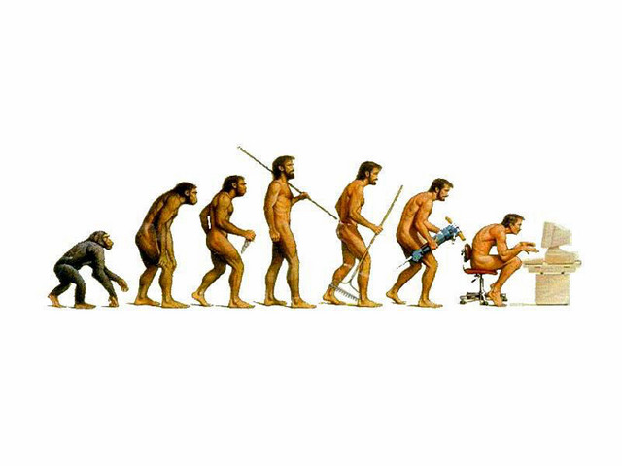
Evolutionary Triggers

Slide 10
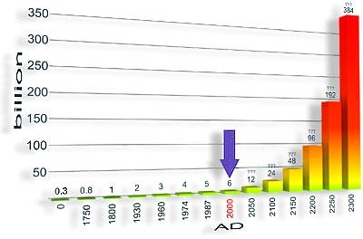
Evolutionary Triggers
Our brains are not optimized for modern society
optimized for small tribal groups
endemic to the african plains
maybe meet 4-5 strangers your entire life
would know 40-50 people at most in your life

Slide 11
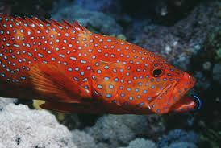
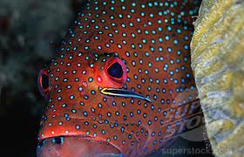
Evolutionary Behavior
Grouper & Cleaner fish
Quiescence dance (the trigger)
evolved instinctual behavior on both sides
evolved trust relationship

Slide 12
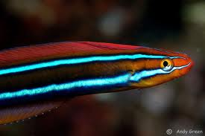
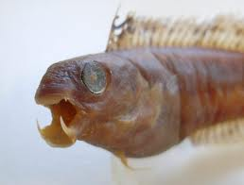
Evolutionary Trigger Exploitation
Mimicry
Batesian mimicry
prey vs predator
Müllerian mimicry
poisonous prey vs predator
Aggressive
predator vs predator

Slide 13
Sabretooth Blenny
Aggressive Mimicry
Sabretooth Blenny learned the Quiescence dance

Slide 14
Persuasion: Exploiting evolutionary triggers
The Harvard 70's compliance study
Goal is to study compliance
(or what is the minimum we need to do/say to get someone to do us a favor?)
Environment
Grad students would approach people in the library who are ALREADY using the copier machine,
They would ask "Can I use the copier because XYZ"
Control group "Can I use the copier"

Slide 15
Persuasion: Exploiting evolutionary triggers
Grad students would approach people in the library who are using the copier machine
Control group "I have 5 pages, can I use the copier."
~ 64 % compliance
no reason given
Trial 1 "I have 5 pages, can I use the copier because I am in a hurry"
~ 94 % compliance
pretty good reason given

Slide 16
Persuasion: Exploiting evolutionary triggers
Researchers asked themselves:
Can we vary the lameness of our reason and explore how it affects that 60%-94% compliance rate range?
explored more and more less-compelling reasons
results still yielded relatively-high compliance, until ultimately..

Slide 17
Persuasion: Exploiting evolutionary triggers
"Hi I have 5 pages, can I use the copier because I need to make copies"
93 % compliance
effectively no reason provided
logically equivalent to "Hi I have 5 pages, can I use the copier"

Slide 18
Persuasion: Exploiting evolutionary triggers
Magic word is "because"
Exploits an evolutionary trigger
like the sabretooth blenny
Our brains aren't optimized for the modern world
Small tribal life had few liars
liars would get exiled or shamed

Slide 19
6 Quirks of the Human Brain
Reciprocity
Consistency
Social Proof
Liking
Authority
Scarcity

Slide 20
Reciprocity
We tend to return favors, regardless of the original favor
even if we didn't want the original favor
Exploited commonly by charities
hand you flowers, a drink, snacks, or souvenirs before asking for donations
exploits the temptation to give back
Doesn't work against Nigerian scammers
Works in negotiation too!

Slide 21
Reciprocity
Exploiting Reciprocity during Negotiation
Make a concession, and ask for one in return
concession might even be irrelevant
Exploited commonly in bartering
Offer outrageous first price, then concede down to a reasonable price
Even when people get ripped off, if a concession is made they end up feeling happier about it

Slide 22
Reciprocity
Exploiting Reciprocity for initiating tricky conversations
"Hey I fixed the printer for you... Hey, is this a good time to talk about by performance evaluation?"

Slide 23
Consistency
We try to be consistent with prior actions, even if the reasons for the original actions have changed
Charities exploit this
Survey then call 2 weeks later

Slide 24
Consistency
Salesmen exploit this
get you to start filling out a form before asking you to commit
surprising how much info they can get just by asking before asking you to decide
name, address, DOB, SSN...
Brain unconsciously makes a commitment to that, and tries to stay consistent
even if the terms change

Slide 25
Social Proof
We try to do and think what other people who seem like us do and think.
Laugh tracks
even work when people know they are in place and know about this trick
Crowd Theory
People behave like the majority of the group
Don't have a heart attack in a group
people collectively freeze, waiting for someone else to take charge

Slide 26
Social Proof
This is how riots work
On their own, individuals usually do not:
go about protesting on their own
burning cop cars by themselves
looting, vandalizing, etc

Slide 27
Liking
We tend to cooperate with someone who seems to like us
good cop, bad cop
Salesmen: "Your friend suggested I call you"
studies show that bad flattery works just as well as accurate flattery
even absurd flattery
"That's a nice tail you have!"
The brain interprets the very attempt at flattery as flattering

Slide 28
Authority
We'll cooperate with someone who seems to be in charge.
"I'm not a doctor, but I play one on TV"
Maxwell House coffee
Sometimes follow orders too closely, too literally
labcoats
badges
security / staff shirts

Slide 29
Scarcity
We tend to over-value apparently scarce resources
Holiday (Xmas) toy/gift crazes, limited time offers
Cookie jar experiments
Censorship = information scarcity
backfires commonly
backfires with juries when asked to ignore invalid/dismissed evidence

Slide 30
Scarcity
Exploiting scarcity to gain access:
"I'm only here until noon, so if you don't authorize me to fix your problem, you'll have to wait till next month for me to return... Good luck explaining that to your boss."
Exploiting scarcity to get a raise:
"You know, Microsoft has been asking me to interview with them..."

Slide 31

In reality
These are tricks that statistically increase the odds of compliance
requires finesse
Won't always work
"I need to fix stuff, so let me in the server room because I need to fix stuff."
"Remember how you gave me a raise last week? Well its about that time again..."

Slide 32
Reality
Social engineering is usually the easiest way into a system
Given a large enough company (# of employees), social engineering tricks are pretty much guaranteed to have some success.
post exploitation spear phishing

Slide 33
Defending yourself
Its really hard!
Raise awareness of these principles
Practice by resisting advertisements
Practice by manipulating your friends
Practice this spring break :)

Slide 34
Resources
Robert Cialdini's book, Influence: The
Psychology of Persuasion
Dr. W. Philip Kegelmeyer's 2007 presentation about the above book: [link]

Slide 35
Technical Resources
http://www.social-engineer.org/

